Slide 1
Minds, Machines, Persons
Consciousness: Part 1

Slide 2
What is consciousness?
Chalmers: The subjective inner life of the mind
Uses ‘consciousness’ and ‘subjective experience’ interchangeably
Other senses of consciousness:
Awake-Consciousness: the state of being awake
You can have subjective experiences while asleep (e.g. a vivid episode of dreaming)
Self-consciousness: awareness of oneself existing over time
There can be creatures that have subjective experiences without a sense of self (e.g. frogs)
Term often confused with consciousness:
Conscience: a moral compass (tells you right from wrong)
Having a conscience might require consciousness but not the other way around
Psychopaths still have consciousness

Slide 3
Denotative Definition (Schwitzgebel)
Examples of things that are part of consciousness:
Sensory experiences
Taste
Smell
Visual experiences
Afterimages
Dreams
Auditory experiences
Bodily sensations
Pain
Tickles
Mental imagery
Imaginative experiences
Inner Speech
Emotions
Happiness
Fear

Slide 4

The taste of chocolate
“What happens, for instance, when you bite into a chocolate bar? The chocolate melts on your tongue and causes chemical changes in your taste buds; the taste buds send some electrical impulses along the nerves leading from your tongue to your brain, and when those impulses reach the brain they produce further physical changes there; finally, you taste the taste of chocolate. What is that?
Could it just be a physical event in some of your brain cells, or does it have to be something of a completely different kind?
If a scientist took off the top of your skull and looked into your brain while you were eating the chocolate bar, all he would see is a grey mass of neurons. If he used instruments to measure what was happening inside, he would detect complicated physical processes of many different kinds. But would he find the taste of chocolate?” –Thomas Nagel

Slide 5
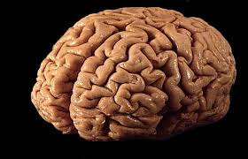
The mind-body problem for physicalism
Physicalism: everything that exists is physical
Ultimately made up on quarks, gluons, etc.
Collections of quarks give rise to atoms, then to molecules, cells, neurons, neural networks, and then consciousness
Consistent with the mechanical world thesis: Everything in the world can be explained in terms of mechanisms and laws of nature
Problem for Physicalism: How does consciousness arise from unconscious matter? How does a physical brain give rise to subjective experiences?
Tim Crane: “We can say our mental capacities are a product of the brain, but we have no idea how it even could happen, it’s completely baffling.”
Notes:
Slight majority of contemporary philosophers are physicalists.

Slide 6


Chalmers on Consciousness
“Conscious experience is at once the most familiar thing in the world and the most mysterious…Why does it exist? What does it do? How could it possibly arise from neural processes in the brain?”
“How it is that anything so remarkable as a state of consciousness comes about as a result of irritating nervous tissue?
It is just as unaccountable as the appearance of the genie when Aladdin rubbed his lamp..”
-Thomas Huxley
Notes:
Note: Not everyone has accepted that consciousness exists. Radical behaviorists reject it.

Slide 7
Easy vs. Hard Problems
Easy Problems:
How is it that subjects can verbalize their thoughts?
What are the mechanisms underlying long-term memory?
Why is it that some individuals are unable to experience fear?
Questions about objective mechanisms to be studied by neuroscientists
Physical structures and functions of brain regions, neurons, glial cells, etc.
Similar to the reductionist explanations in biochemistry
Reduction of one set of objective mechanisms to another set
Hard Problem: Why do processes in the brain give rise to subjective experiences?
“Could not an unconscious automaton have performed the same tasks just as well?” (Chalmers, pg. 2)

Slide 8
Can consciousness be explained?
Three Views:
Reductionism: Consciousness can be explained in terms of material entities like neurons or neural networks (Dennett, Churchland)
The Mind-Brain Identity Theory is an example of a reductionist theory
Nonreductionism: Consciousness can be explained, but not in terms of some simpler material entities
Consciousness cannot be reduced down to anything more basic
It’s an element of the universe
Substance Dualism is a nonreductionist theory (Mind and Matter as the two basic elements)
Mysterianism: Consciousness cannot be explained at all (Locke, Chomsky, McGinn)

Slide 9
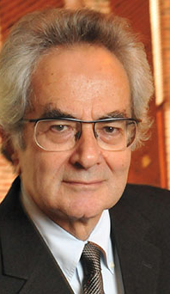
Thomas Nagel (1937-present)
American philosopher at NYU
Known for work in:
Philosophy of mind
Ethics
Political philosophy
Famous books: “The view from nowhere”, “Mortal questions”
“What is it like to be a bat? (1974)
Challenges both physicalist and reductionist accounts of the mind
Understands physicalism and reductionism as a package

Slide 10
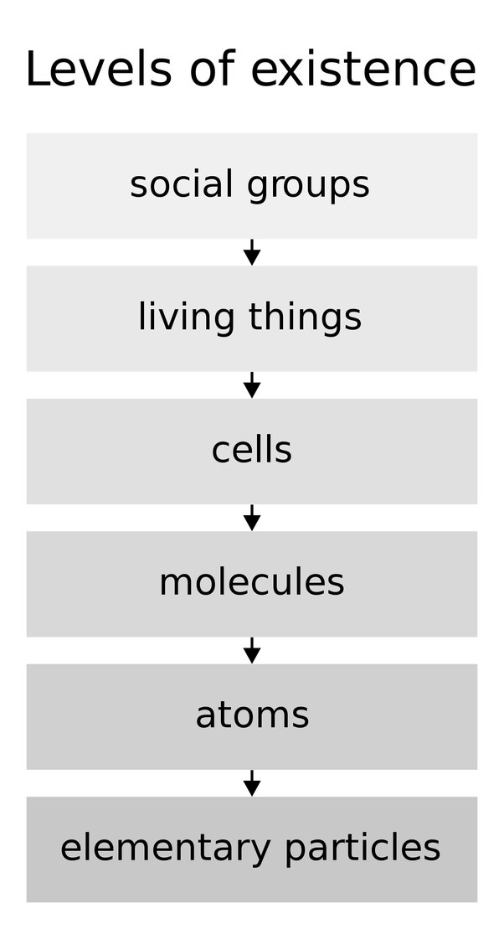
Reductionism in Science
Reduction in science
The idea: One set of phenomena is a complex arrangement of a more fundamental set of phenomena
Organisms are a complex arrangement of cells
Cells are a complex arrangement of molecules
Molecules are a complex arrangement of atoms
The reduction of life
How do you get life from nonliving molecules?
In the 18th and 19th centuries, this was thought to be a mystery
Nonreductionist theory of life: Vitalism
Vitalists: We need to add a vital forcefield to explain life
Modern biochemistry: Cells reduce to complex collections
of molecules
No need to posit a vital forcefield
Right organization of molecules gives you life

Slide 11
Why consciousness is different
We can reduce behavior to neuronal firings and biochemical reactions
But the presence of consciousness would not be explained
“The most important and characteristic feature of conscious mental phenomena…Most reductionist theories do not even try to explain it.” (166)
Subjective character of experience
Conscious experience- when there is “something that it is like to be that organism”
(Phenomenal) consciousness
Humans and nonhuman animals have conscious experiences
Nagel: Functional states of a system will not explain the experiential properties
Failure of many theories of mind (functionalism, behaviorism)

Slide 12
Recent attempts at explaining consciousness
Widespread agreement that consciousness is real and in need of explanation
The Crick-Koch Hypothesis:
Consciousness arises from neural firing in the cerebral cortex
Correlations between self-reported conscious experiences and cerebral cortex neural firing
How does consciousness arise from neural oscillations?
Nonconscious matter just produces experiences?
Nagel: Even if this were true, it would still be a mystery
The Hammeroff/Penrose Hypothesis
Consciousness arises from quantum-mechanical processes taking place inside neuron microtubules
Same analysis applies here
Why does it arise from activity of neuron microtubules?

Slide 13
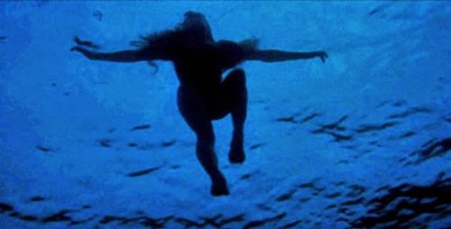
The what it’s like expression
Something it’s like to be a dog
Smell experiences
Visual experiences (partially color blind: see yellow and blue)
Something it’s like to be a whale
Tactile experiences (blow hole sensations)
Visual experiences (partially color blind: see red)
Auditory experiences (whale song communication)
Something it’s like to be a shark
Visual experiences: Total color blindness
Pain experiences: Probably nonexistent (no nociceptors, evidence of pain behaviors)
Something it’s like to a blind human
Lack of visual experiences
Common misconception: Blindness is like being in a pitch-black room
Something it’s like to see (humans born blind don’t know what it’s like)
X

Slide 14
TPS Exercise: What it’s like
Part 1: Think | Individual brainstorming and writing (5 minutes)
Given what you know, choose a nonhuman animal (e.g. a cat, a dog, a bat, bumblebee, a dolphin) and try to offer a description of what it’s like to be them
What kinds of color experiences do they have? Do they experience emotions? Do they have experiences radically unlike our own?
Part 2: Pair (3 minutes)
Team up with a classmate or two and share your answers
Part 3: Share
Share the highlights of your discussion with the class

Slide 15



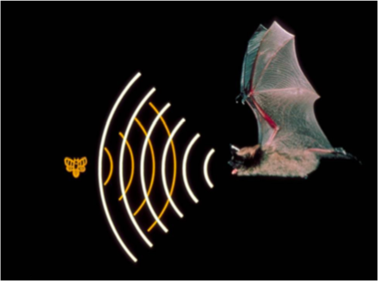
What are Qualia?
Def. The qualitative features that make up conscious experience(s)
Singular: quale
Examples of qualia:
The redness of a ripe tomato
The sweetness of chocolate
The painfulness of a leg break
The bat’s experience of echolocation
The smelliness of durian
The building blocks of experiences
Qualia are the parts, the whole is consciousness
Notes:
What some examples of qualia that you’re aware of right now?

Slide 16


What it’s like to be a bat
There’s something it’s like to be a bat
Echolocation as a form of perception
Probably much different than human vision
How might we be able to know what it’s like?
Proposal 1: Virtual reality machine
Upside down experiences
Flight
Distorted vision
Nagel: This wouldn’t tell you what it’s like to be a bat
Proposal 2: Metamorphosis
Vampires don’t know what it’s like to be a bat either
They know what it’s like to be a human inside of a bat’s body

Slide 17
Subjective experiences
The virtual reality machine would tell you what it would be like for a human to behave like a bat
Want to know what it’s like for a bat to be a bat
Problem generalizes to other kinds of experiences:
What is it like to be blind?
What is it like to be a bee?
What is it like to have vision?
What is it like to be Barack Obama?
Subjective facts about what these experiences are like
Our concepts cannot communicate experiences to those who have not had those experiences
Nagel: Seems unlikely that a future science will be able to tell us what these experiences are like

Slide 18
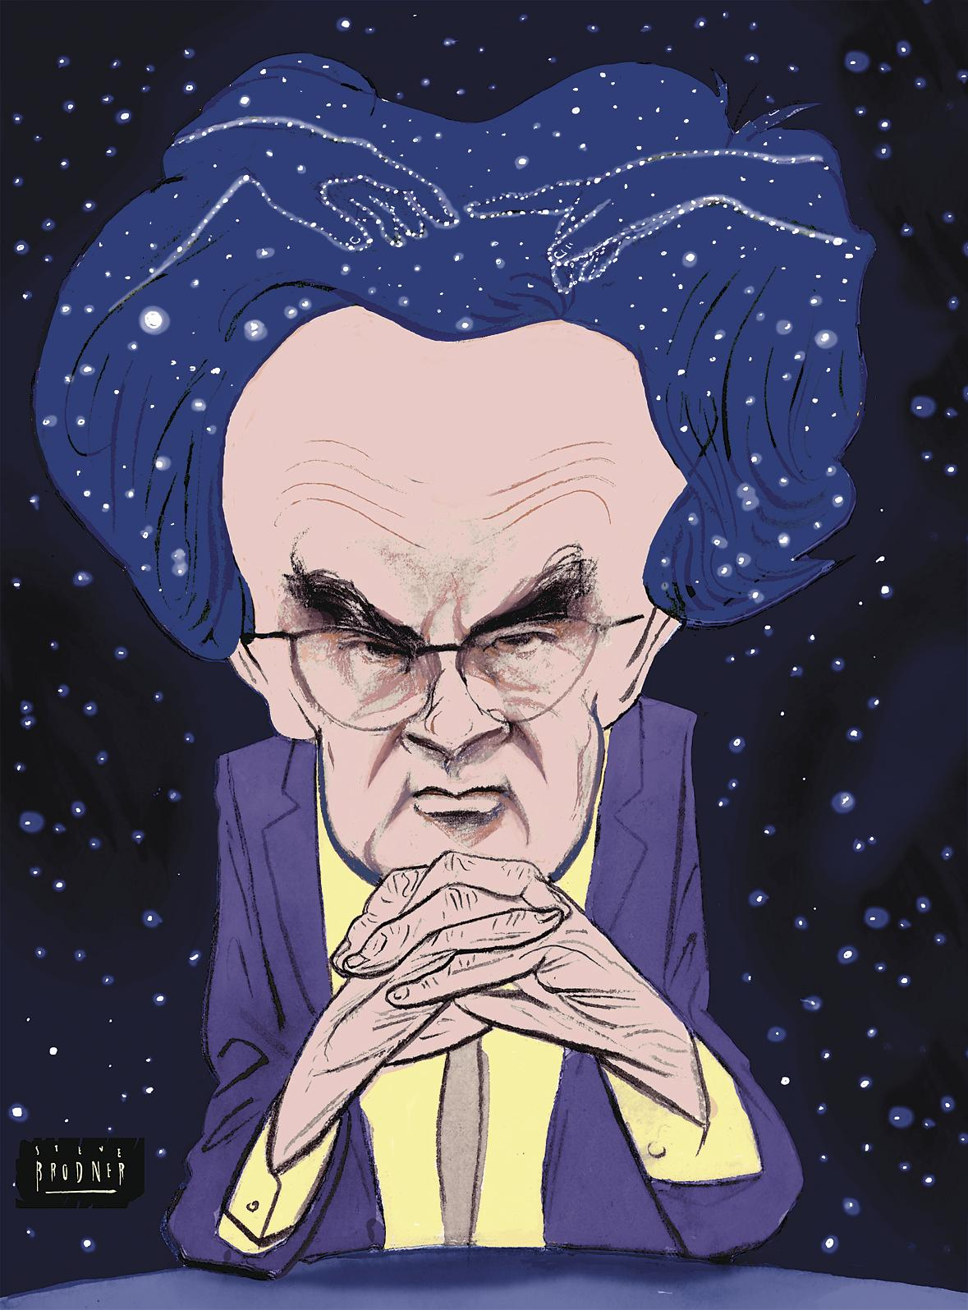
“If physicalism is to be defended, the phenomenological features must themselves be given a physical account. But when we examine their subjective character it: seems that such a result is impossible. The reason is that every subjective phenomenon is essentially connected with a single point of view, and it seems inevitable that an objective, physical theory will abandon that point of view” (Nagel, 437)

Slide 19
Optimistic possibility
Humans will someday invent concepts that can be used to communicate the features of conscious experiences
Concepts that will allow a blind person to know what it’s like to see (without having the experience)
"Red is like the sound of a trumpet”
New theories or frameworks would be needed to do this
We need a Darwin of Consciousness Science

Slide 20
Pessimistic possibility
Humans are incapable of possessing the concepts required to understand consciousness
Ants incapable of understanding how microwaves work
Advanced aliens might be capable of possessing the necessary concepts to understand consciousness
Cognitive closure
Mysterianism (McGinn, Locke)

Slide 21
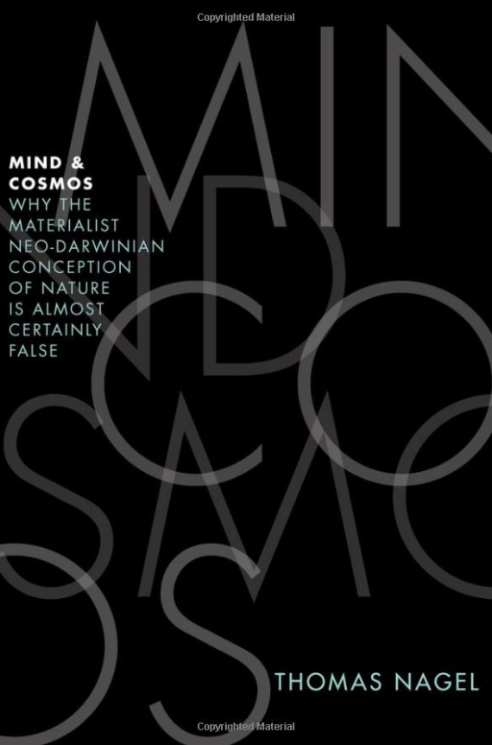
Nagel’s main points
1) There are limits to our knowledge about consciousness
The bat argument
2) These limits make it difficult for us to understand how physicalism could be true
Discussion is not intended as a refutation of physicalism
It is a challenge directed at physicalism*
Implications of the essay: We should take non-physicalist theories seriously
Property dualism
Notes:
Can be developed into an argument against physicalism

Slide 22
Nagel’s critique of physicalism
Part 1: The Bat Argument
(1) If x is not a bat‑type creature, then x does not have a bat’s point of view
(2) If x x cannot know what it is like to be a bat.
Therefore,
(3) If x is not a bat‑type creature, then x cannot know what it is like to be a bat.
(4) You are not a bat‑type creature.
Therefore,
(5) You cannot know what it is like to be a bat

Slide 23
The anti-physicalist argument
Many philosophers agreed with Nagel’s points about the limits of our knowledge and the limitations of physicalism
Later authors have developed arguments in the vein of Nagel that aim to refute physicalism
P1. If physicalism is true, then a human, who knows everything physical about bats, knows everything about bats (P→Q)
P2. If the expert knows everything about bats, then they must know what it’s like to be a bat (Q→R)
P3. But the expert cannot know what it’s like to be a bat (~R)
P4. So, the expert who knows everything physical about bats doesn’t know everything about bats (~Q)
C. Physicalism is false (~P)

Slide 24
Objection 1: We can do it!
Dennett: Even as humans, we can know what it’s like to be a bat
Unique qualitative properties of bats (e.g. what it’s like to echolocate) might not exist
Could be a form of unconscious perception (radar gun analogy)
Complete study of bat physiology, behavior, and neuroscience should tell us everything
Do you think Dennett is right about this?
Notes:
Dawkins quote on bats: “The Doppler Effect is used in police radar speed-traps for motorists … By comparing the outgoing frequency with a frequency of the returning echo the police, or rather their automatic instrument [my emphasis], can calculate the speed of each car .. By comparing the pitch of its cry with the pitch of the returning echo, therefore, the bat (or rather its on-board computer in the brain) [my emphasis] could, in theory, calculate how fast it was moving towards the tree”

Slide 25
Objection 2: What’s the problem?
Why does physicalism need to tell us what it’s like to be a bat?
Seems like on can accept both:
There are facts about bat experiences that cannot be grasped by humans
Everything in the universe (including bat experiences), is made up of physical objects and properties
Nagel: Right, but it would leave us without any understanding of how physicalism is true
No explanation for why consciousness arises
Seems like physicalists are forced to appeal to mystery
Somehow brain processes cause visual experiences
This is unsatisfactory
Notes:
Caterpillar thought experiment (analogy)

Slide 26
The return to dualism
Many philosophers have been convinced by Nagel’s argument
Something wrong with reductionism and/or physicalism
Mental properties are irreducible from physical properties
Cannot be explained in terms of neural entities and processes
Explanatory gap
Examples of mental properties: consciousness, intentionality
Property Dualism: Two fundamentally different kinds of properties
Physical
Non-physical (mental)

Slide 27
The return to dualism*
Most property dualists reject substance dualism
Typically accept substance monism (only one kind of stuff in the universe)
Everything in the universe is a physical object, but some have nonphysical properties that emerge
Some physical objects have emergent properties (e.g. consciousness) that are irreducible to physical properties of the brain (e.g. weight, density, electrical activity)
Some philosophers believe that this kind of dualism is compatible with physicalism (e.g. Fodor, Putnam)
Nonreductive physicalism (Property dualism + physicalism)
Nagel, Kim, and Schneider reject the compatibility

Slide 28

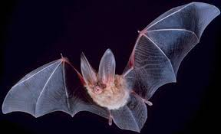

Arguments for (property) dualism
Nagel’s “What it’s like to be a bat” argument
Chalmer’s “Zombie” argument
Jackson’s Mary argument

Slide 29

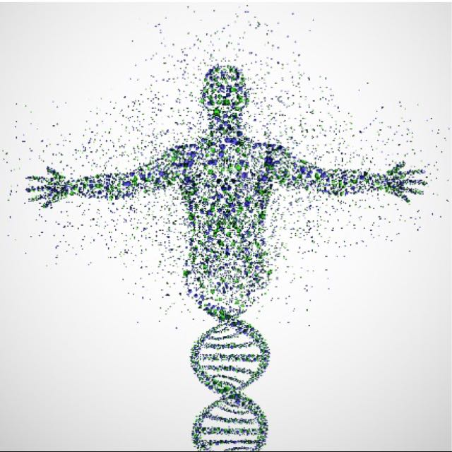
The Zombie World
Imagine a world with beings that are physically and behaviorally indistinguishable from humans
They can speak and understand language
They scream “Ow!” when they stub their toe
They express emotion (face and body language)
They talk about consciousness and zombies
They have the same brains that we do
But they don’t have any qualia (nothing it’s like)
Why didn’t creatures like these evolve?
Seems like zombies are possible (there could have been a zombie world)
Chalmers: We need an answer this question to solve the problem of consciousness
PAININ
Notes:
Assumes there isn’t a function to consciousness or qualia. There very likely is!

Slide 30
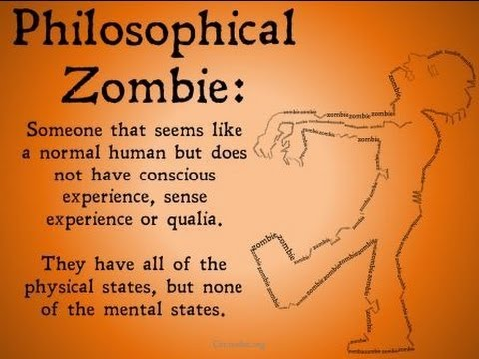
The Zombie Argument (Chalmers)
P1. If zombies are (logically) possible, then physicalism is false
P2. Zombies are conceivable (or imaginable)
P3. Zombies are possible
If something is conceivable, then it is (logically) possible (Conceivability principle)*
C. Physicalism is false
Notes:
Tell story about worries about zombies as a child. Mom’s reaction.

Slide 31

The Zombie Argument
This is a variation of Descartes’s conceivability argument
Kripke develops his own variation (Imagines pain without C-fibers)
P1 is true (Universal agreement)
If you have two beings that are physical duplicates, then they would be psychological duplicates (physicalism)
Why would one have full blown consciousness, and the other nothing at all?
The explanation would have to involve some nonphysical property (consciousness)
PAIN

Slide 32
Responses to the Zombie Argument
Premise 2: Most philosophers think zombies are conceivable (~60%)
Objection: Upon close inspection, zombies are incoherent
You can’t just take off consciousness, leaving everything else intact
Jacket Fallacy (Kirk)
Analogy: Try to imagine two beings that are physically and behaviorally identical but one is healthy, the other is not (Dennett)
This is impossible
You’re not really conceiving of a zombie, it only seems like you are
We can be mistaken about what we’re thinking about

Slide 33
Other responses to Zombies
P3 is false
Inference from P2 to P3 is invalid
Conceivability principle originates from David Hume
Accepted by many philosophers throughout history (e.g. Descartes, Berkeley, Chalmers)
Objection: Conceivability is not a foolproof guide to possibility
There are conceivable impossibilities

Slide 34
Counterexamples to the C.P.
Example #1: History of science
It was once conceivable that X is not Y
Hesperus≠Phosphorus, Water≠H20, Heat≠Electromagnetic radiation
Example #2: Philosophy of religion
The existence of a necessary being is either necessarily true or necessarily false
God exists out of necessity or God is impossible (something incoherent about the nature of a necessary God)
Conceivable that theism* is true, and conceivable that atheism is true
Agnosticism can be rational
But one of these views is necessarily false (logically impossible)
Takeaway: We can sometimes conceive of things that are logically impossible
Theists conceiving of an impossible God
Atheists conceiving a godless universe

Slide 35
Next Time
The Knowledge Argument (Jackson)
Objections
Replies (The Churchlands, Dennett, Lewis, and Crane)

